Slide 1
Cegal in-person Krafthack 2022

Slide 2
Page number
Agenda points

Slide 3
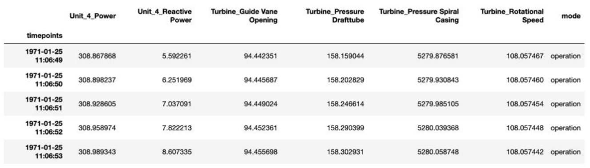
Problem
Prediction data in dataset from sensors
Predict the future tensile values of the 6 bolts with sensors

Slide 4
Exploration and prepping
Removing extreme values
Splitting startup and production data
Removed columns of vibration values because of lacking data
Missing values handled by

Slide 5
Model
Regression model

Slide 6
Production
Updating the model – retrain
Publishing to Azure
Json file to PowerApps
Dashboard notifying maintainers about predictive values

Slide 7
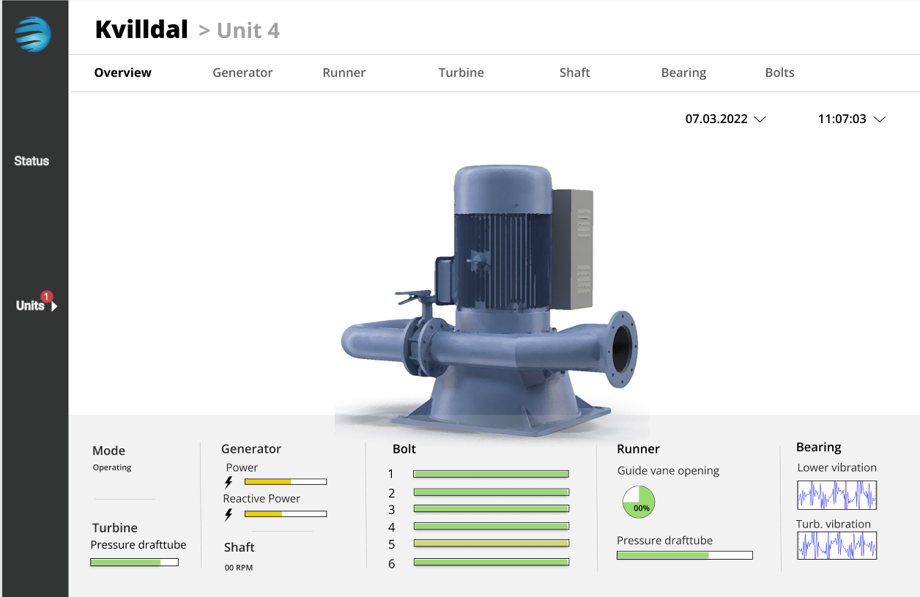
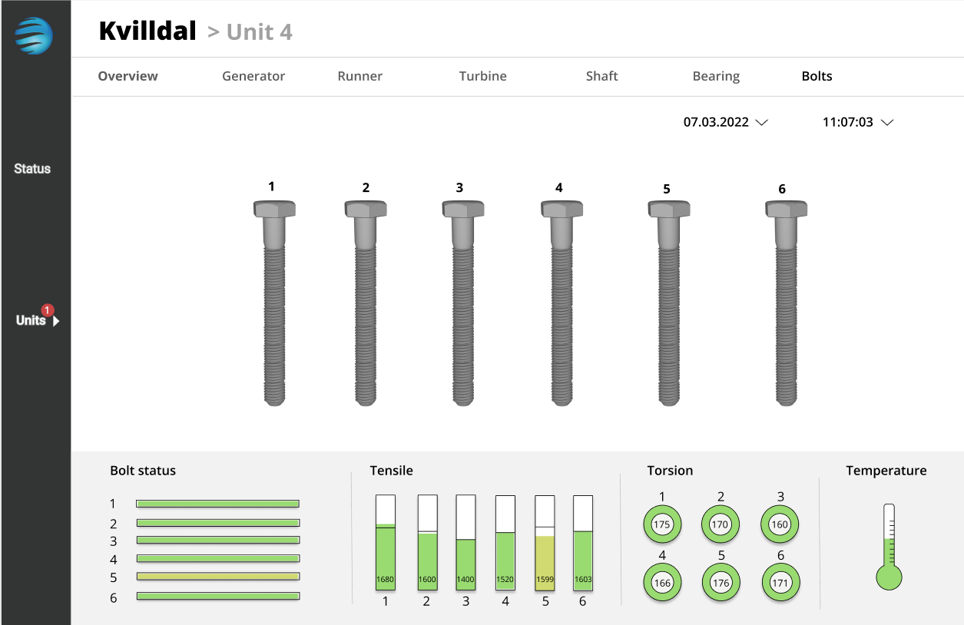
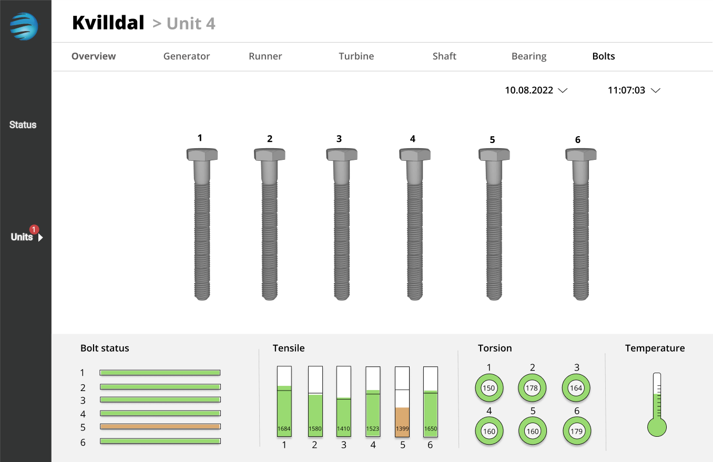
Production – predictive dashboard

Slide 8
Scalability and transferability
Other applications:
Estimate max power production based on weather conditions and season
Sub-sea installations
Oil rig installations
Maintenance of elevators
Cars service interval
Stock prices

